Slide 1
‘God has done great things for me …’ Luke 1:46)

Slide 2
‘They were surprised to find him talking with a woman’. John 4:27-30

Slide 3
‘Jesus loved Martha and her sister and Lazarus’. John 11:28-29

Slide 4
‘He is risen!’ Luke 24: 9-12

Slide 5
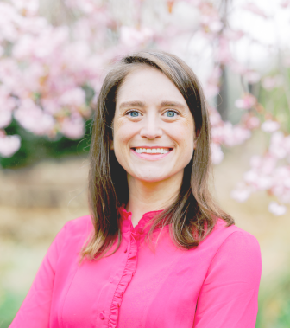
Thinking Jesus was the gardener, Mary said, "Sir, if you have taken his body away, please tell me, so I can go and get him."
Then Jesus said to her, “Mary!"She turned. She said to him, "Rabbouni"—which means "Teacher."
Jesus then told her, "Don't hold on to me! I have not yet gone to the Beloved. But tell my other disciples that I am going to my Beloved and your Beloved, my God and your God."
Mary Magdalene then went to the disciples with the message, "I have seen the Teacher!" And she told them what he had said to her. (John 20: 14-18)
Mary of Magdala, Apostle to the Apostles, first to witness to the Resurrection, is the first to be called by name and commissioned to proclaim the Good News by the Risen Christ. As Fr. James Martin SJ has expressed it, "The Risen Christ appeared first to Mary Magdalene, not to a man. Any discussion of women's roles in the church must begin here.“
So today, like Mary of Magdala, we proclaim with joy the Good News: Christ is with us! God calls women to preach, teach, and lead. And for that, we rejoice.
An Easter Greeting sent from Kate McElwee, Executive Director, Women’s Ordination Conference (WOC) Washington, to Catholic women worldwide, April, 2023

Slide 6
We are invited to pray together …
God of All Possibility, Mary’s fiat was a “Yes” that enfleshed divinity, that shook the foundations of power, that bore You through her human body to a broken world. You promised her that with You, nothing will be impossible.
And so, we pray that women may bear the image of Christ, as Mary did. That women may yet say, “This is my body, this is my blood,” as Mary did. That women may preach the raising of the lowly and the humbling of the powers that be, as Mary did.
We pray that You bless us in bringing to birth a new Church where all may live into the fullness of their callings. Mary brought Christ into the world. Through your power and possibility may women today do the same.
Holy Spirit of justice and wisdom, may we as children of God all be seen as equal in dignity, each free to follow the call of our Baptism to serve you and your people, for the sake of Christ’s Kingdom.

